Slide 1


Human Trafficking: What You Need To Know About Youth Trafficking
Notes:
Victim and survivor will be used in this presentation, as these are legal terms, but many individuals experiencing trafficking prefer not to be called by these names. If at any point you feel uncomfortable, feel free to exit the room. Ms. Barlow, our crisis counselor will be available to provide support for anyone who may need it, her contact information will be given in the post-presentation survey.

Slide 2
Today’s Agenda
Dive into the issue of human trafficking within schools including indicators, vulnerabilities, and roots.
Explore different ways you can help bring change in your school and community.

Slide 3
What is Human Trafficking?
According to federal law, human trafficking is the exploitation of a person through force, fraud, or coercion for the purpose of forced labor, commercial sex, or both.
Notes:
https://safesupportivelearning.ed.gov/human-trafficking-americas-schools In legal words…
There is no such thing as commercial sex involving a minor, it is legally considered trafficking.
This is human trafficking in legal terms, however…

Slide 4
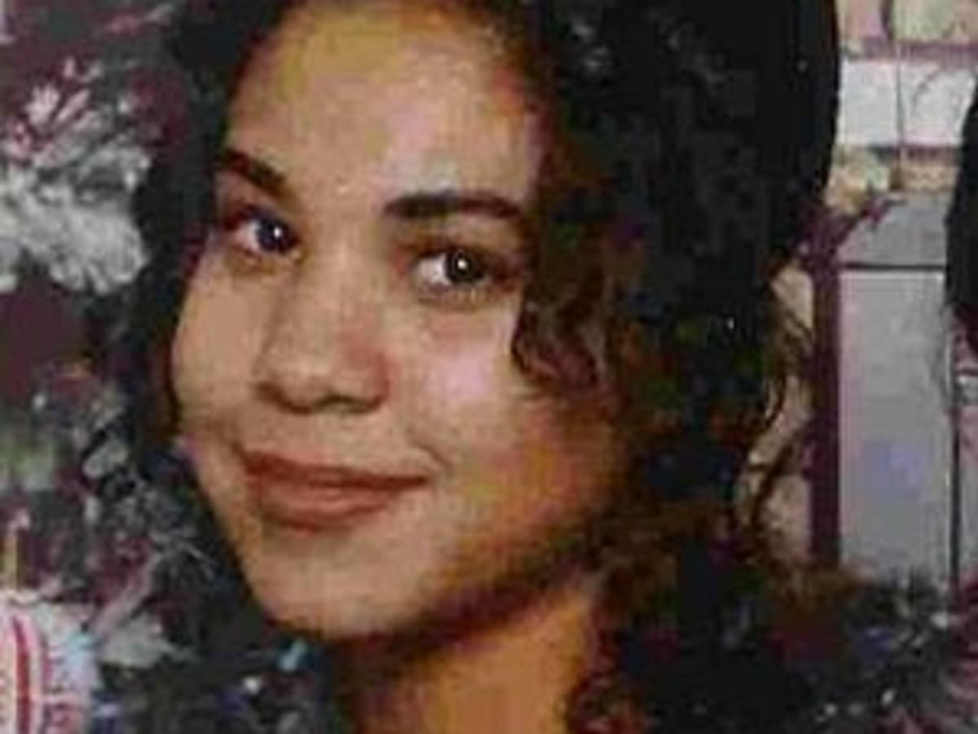

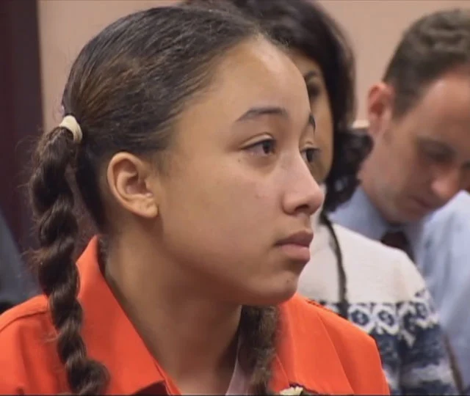

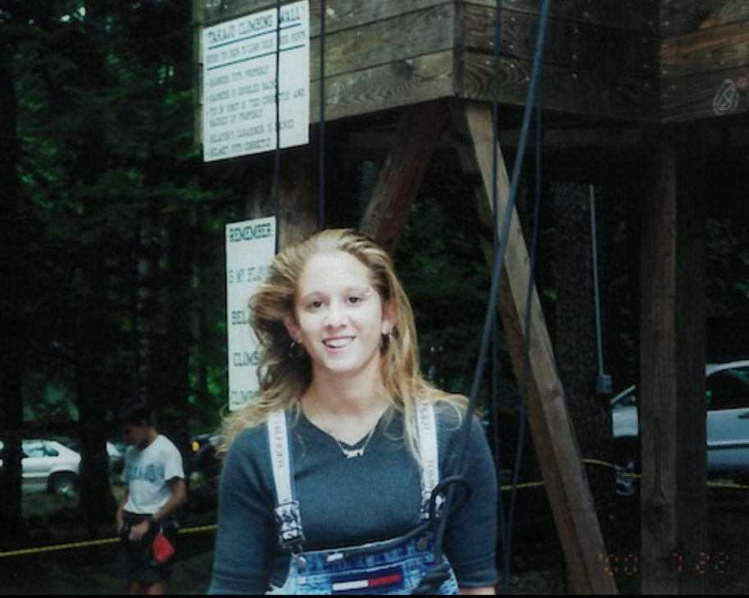
Notes:
This is actually human trafficking. This is what it looks like. Children, teens just like you and I are trafficked all over our country and in our city all the time. This impacts every single one of us here today, everyday we are at risk. These children represent us, and we must support them. Living in fear is not be an option, so we must create change.
Danielle Douglas, Chrystul Kizer, Sara Kruzan, Cyntoia Brown, Samuel Marino

Slide 5
True or False:
Human Trafficking Only Includes Sex Trafficking.
Notes:
First, let’s acknowledge the truths and myths of human trafficking. Human trafficking only includes sex trafficking. True raise your hand, false raise your hand.

Slide 6
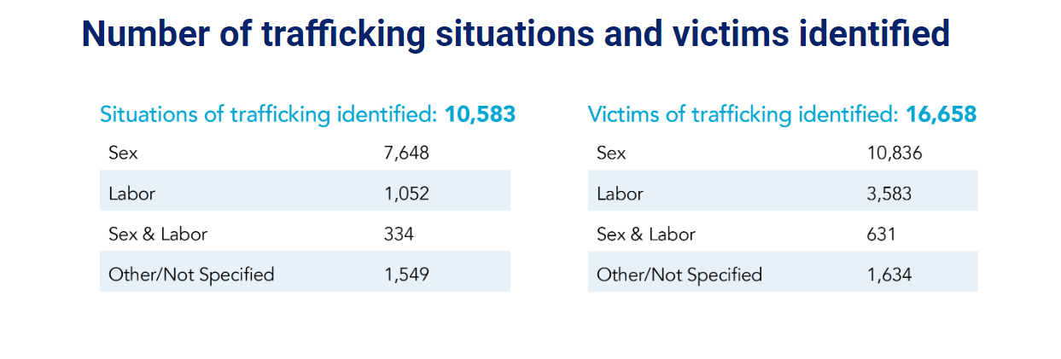
FALSE

Slide 7
True or False:
Only Women are Trafficked

Slide 8
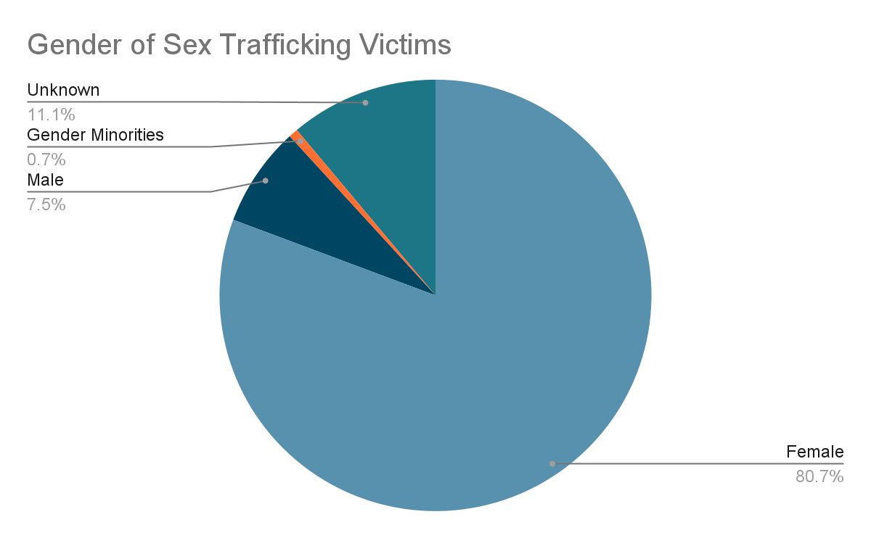
FALSE
Notes:
While a large percentage of victims are female, almost 8% are men. Men can be victims too.

Slide 9
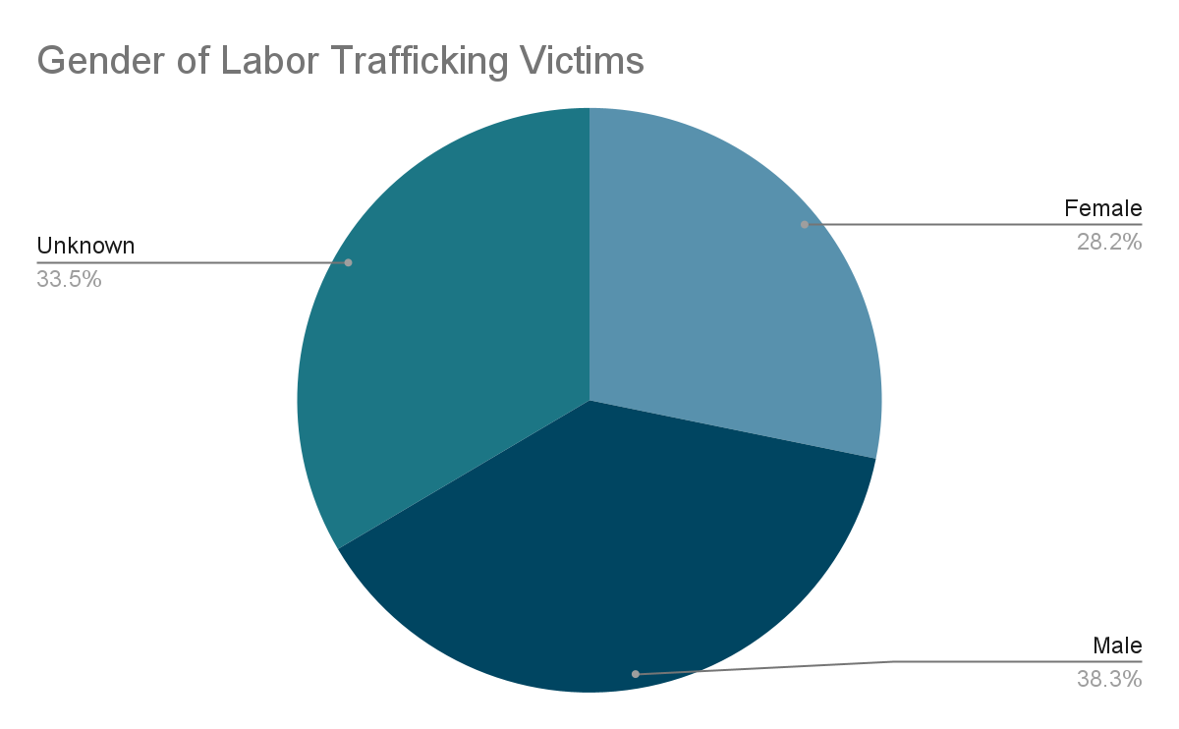
FALSE
Notes:
Should I make my own chart including only the overall information or only Labor/Sex?

Slide 10
True or False:
Human Trafficking and Human Smuggling Are The Same
Notes:
Might be overkill to have all three in red bold, maybe only the same?

Slide 11
FALSE
Trafficking is based on exploitation and doesn’t require movement across borders.
Notes:
https://www.dhs.gov/blue-campaign/myths-and-misconceptions#:~:text=Myth%3A%20Human%20trafficking%20and%20human%20smuggling%20are%20the%20same.&text=%E2%80%9CTrafficking%E2%80%9D%20is%20based%20on%20exploitation,in%20violation%20of%20immigration%20laws.

Slide 12
True or False:
People Are Normally Trafficked by Strangers

Slide 13
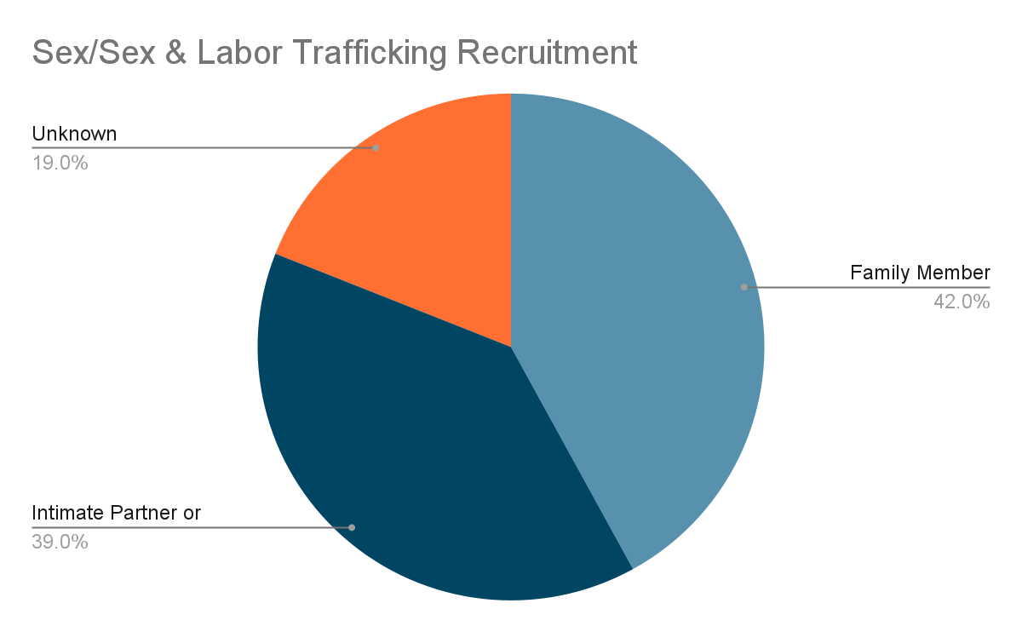
FALSE

Slide 14
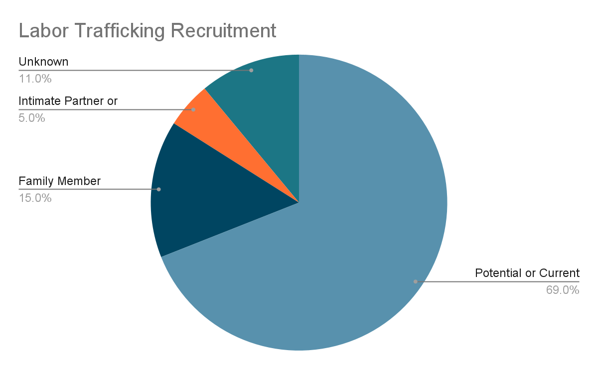
FALSE

Slide 15
True or False:
Victims Are Controlled Through Only Physical Force

Slide 16
FALSE
Threatening family or friends
Debt
Physical, sexual, or emotional abuse
Drugs
Shame
Threatening deportation
Taking legal documents
Notes:
There are many ways traffickers control victims, including both psychologically and physically.
https://www.manhattanda.org/victim-resources/human-trafficking/

Slide 17
Tonya spent night after night in different hotel rooms, with different men, all at the command of someone she once trusted. She was held against her will, beaten and made to feel like she had no other option at the time, all by the man she thought she loved.
She felt she deserved it. Tonya felt she couldn’t escape. Afraid and confused, she thought the emotional and physical abuse she endured was her own doing.
TONYA COULD BE ANY OF YOU
Notes:
https://dailybruin.com/2020/05/27/the-quad-examining-what-human-trafficking-is-misconceptions-surrounding-it
Let’s hear an anecdote from a human trafficking victim.
Tonya could be any of us. Trapped in a cycle of abuse with seemingly no way out.

Slide 18
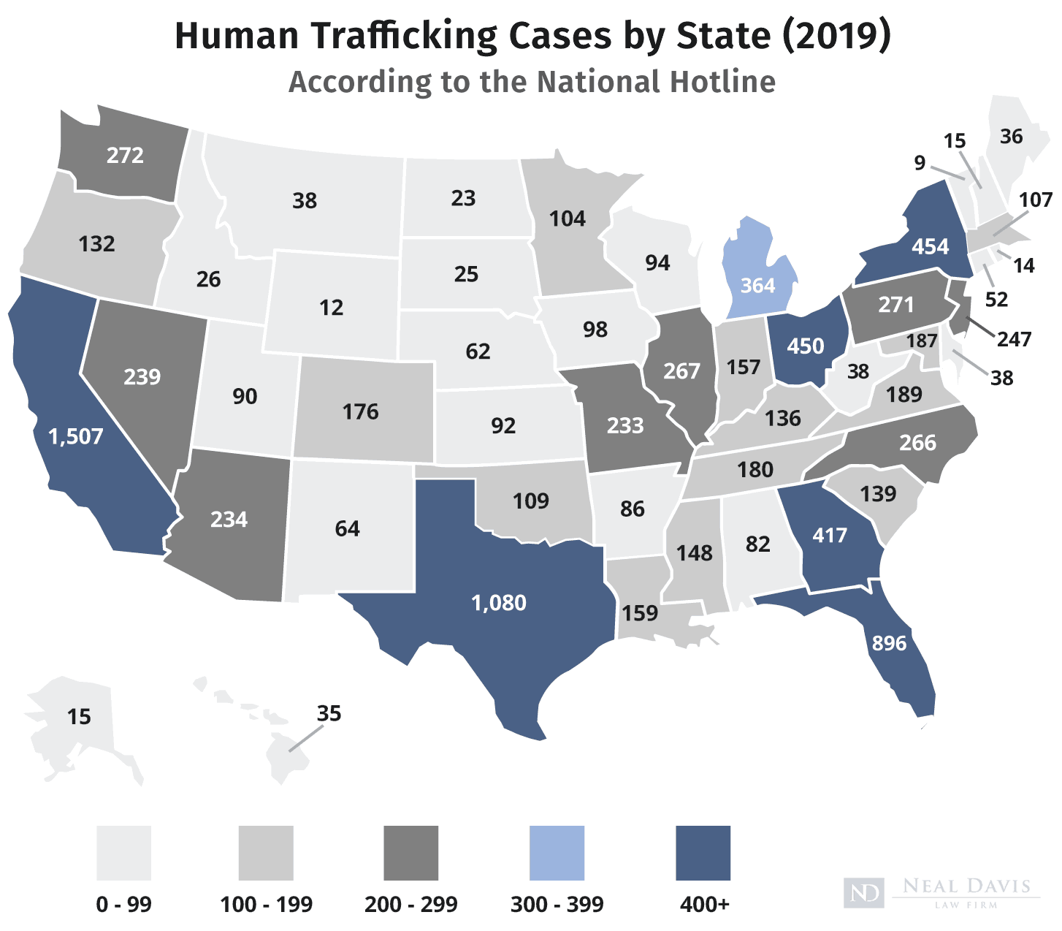
Notes:
Maybe change the place.
https://www.nealdavislaw.com/press/human-trafficking-statistics-2019-report.html
In fact, take a look at this map showing the Human Trafficking Arrests by State in 2019. Keep in mind, these numbers only account for reported cases, thousands even millions of cases of trafficking go unreported each year.
With 454 reported cases, New York is reported as one of the top 5 states with the highest reports of trafficking.
These numbers have only risen since, especially due to the COVID-19 pandemic.
https://www.nealdavislaw.com/criminal-defense-guides/human-trafficking-statistics.html#top-10-states
https://humantraffickinghotline.org/state/new-york incorporate somehow?

Slide 19
What Are The Risk Factors/Vulnerabilities For Child Trafficking?
Runaway/homeless youth
Unstable housing
Current or past involvement in the child welfare system
Poverty
Youth with a criminal history
Dropout youth
Youth with disabilities
LGBTQ youth
Migrant workers
Involvement with gangs
Notes:
Let’s look at the risk factors and vulnerabilities for child trafficking.
It is estimated that 60% of trafficked children are runaway or homeless youth.

Slide 20
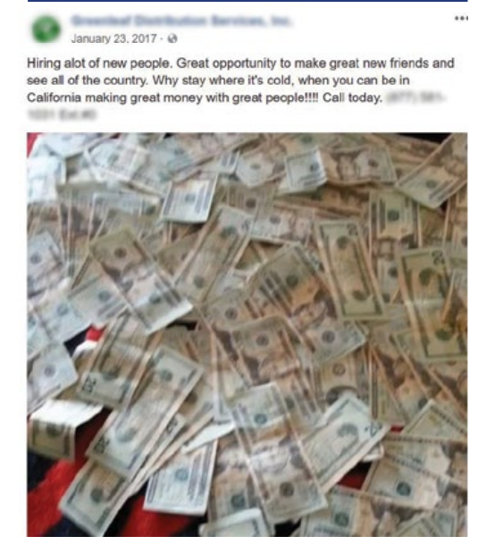
Notes:
Now with social media, trafficking has become even more prominent. The above image was taken from a public Facebook post of trafficking recruitment disguised as a door-to-door sales company.

Slide 21
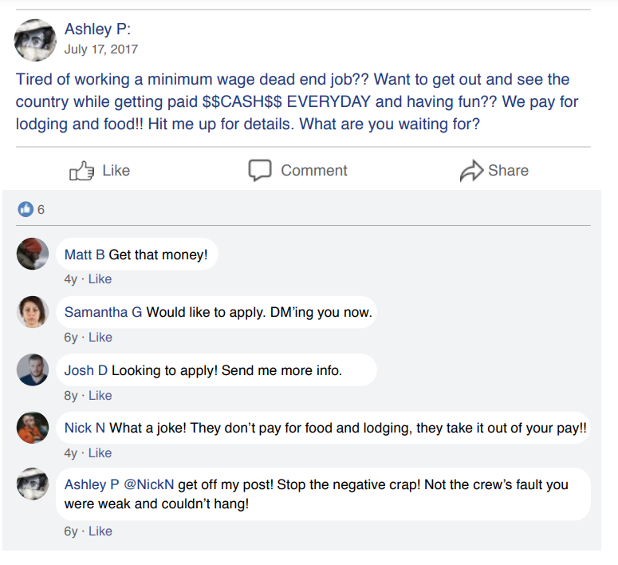
Notes:
Here is another example of recruitment on social media. This is based on actual public comment threads but has recreated to protect any potential victims.
https://polarisproject.org/wp-content/uploads/2018/08/A-Roadmap-for-Systems-and-Industries-to-Prevent-and-Disrupt-Human-Trafficking-Social-Media.pdf

Slide 22
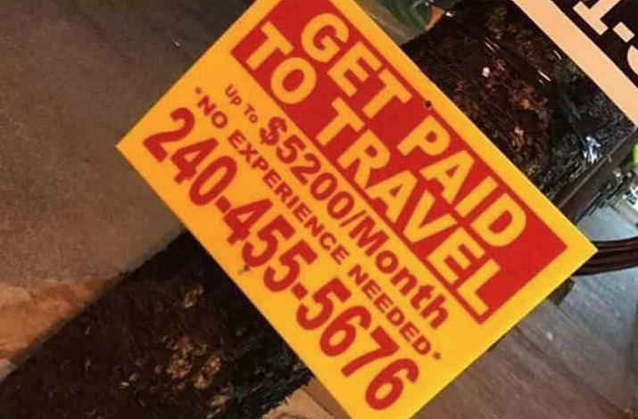
Notes:
Here is another non-social media job scam.
https://theamericangenius.com/business-news/human-sex-trafficking-job-scams/

Slide 23
What Does Human Trafficking Look Like in Students?
Mental health issues
Change in behavior
Decline in academic performance or sudden unexplained absences
Talking about working excessively long hours
No longer attending youth activities normally attended
Chronically running away from home
Suddenly having more material possessions
Notes:
Some indicators of trafficking include

Slide 24

Notes:
Let’s revisit Tonya and listen to the emotional toll the trafficking put her through. No one deserves to feel like this. It’s important to look for these signs and reach out when we notice them. Now, let’s take a look at how YOU can help ensure no one feels like this. (kind of extreme so maybe instead- how YOU can help to make a difference).

Slide 25
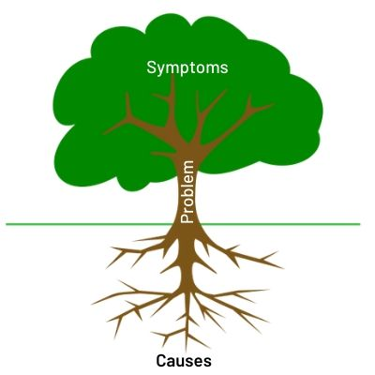
Why Does This Persist?
Roots of Trafficking:
Supply and demand issue
High reward low risks for
the trafficker
Economic stress
Notes:
Make this two slides, for roots add a tree image and trends add a chart with arrow going up image.
Add on here. Make two slides
Add trends why increasing?
In order to know how to help, we must first identify the roots of human trafficking. Human trafficking is a supply and demand issue. So in order to stop the supply, you must eliminate the demand.
Since LGBTQ+ youth are at risk, we should foster an accepting…

Slide 26
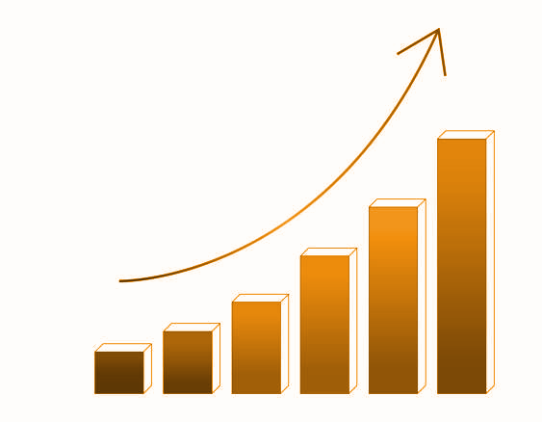
Why Does This Persist?
Trends
Online recruitment up 22%
Recruitment by family members up 47%
Recruitment by intimate partners up 21%
Overall increase in human trafficking
COVID-19
Climate change
Displacement and lack of safe migration pathways
Notes:
Make this two slides, for roots add a tree image and trends add a chart with arrow going up image.
Add on here. Make two slides
Add trends why increasing?
In order to know how to help, we must first identify the roots of human trafficking. Human trafficking is a supply and demand issue. So in order to stop the supply, you must eliminate the demand.
Since LGBTQ+ youth are at risk, we should foster an accepting…

Slide 27
How Can You Help?
Educate yourself and others
Spread awareness
Be aware of brands that benefit from trafficking and limit consumption of their products.
Forever 21, Urban Outfitters, Ralph Lauren, Hershey’s, Macy’s, Target, IKEA, etc.
Foster an accepting environment for LGBTQIA+ youth
Limit the use of pornographic material.
Notes:
Add on here. Touch base with professor Ades, do victims realize they’re victims, how do they feel? Feed into the signs or what you can do to help.
In order to know how to help, we must first identify the roots of human trafficking. Human trafficking is a supply and demand issue. So in order to stop the supply, you must eliminate the demand.
Since LGBTQ+ youth are at risk, we should foster an accepting…

Slide 28
Who You Can Reach Out To
National Human Trafficking Hotline
888-373-7888
233733 (Text "HELP" or "INFO")
https://humantraffickinghotline.org/
Notes:
Add on here.

Slide 29
Find Out More:
Rebecca Bender E-Course
Your Slavery Footprint
Human Trafficking Training
Tonya and Her Story
Explained Increase In Human Trafficking and How to Stop It
Notes:
If you would like to know more about human trafficking, here are some resources you can look into. These will also be included in the google form.

Slide 30
Questions?

Slide 31
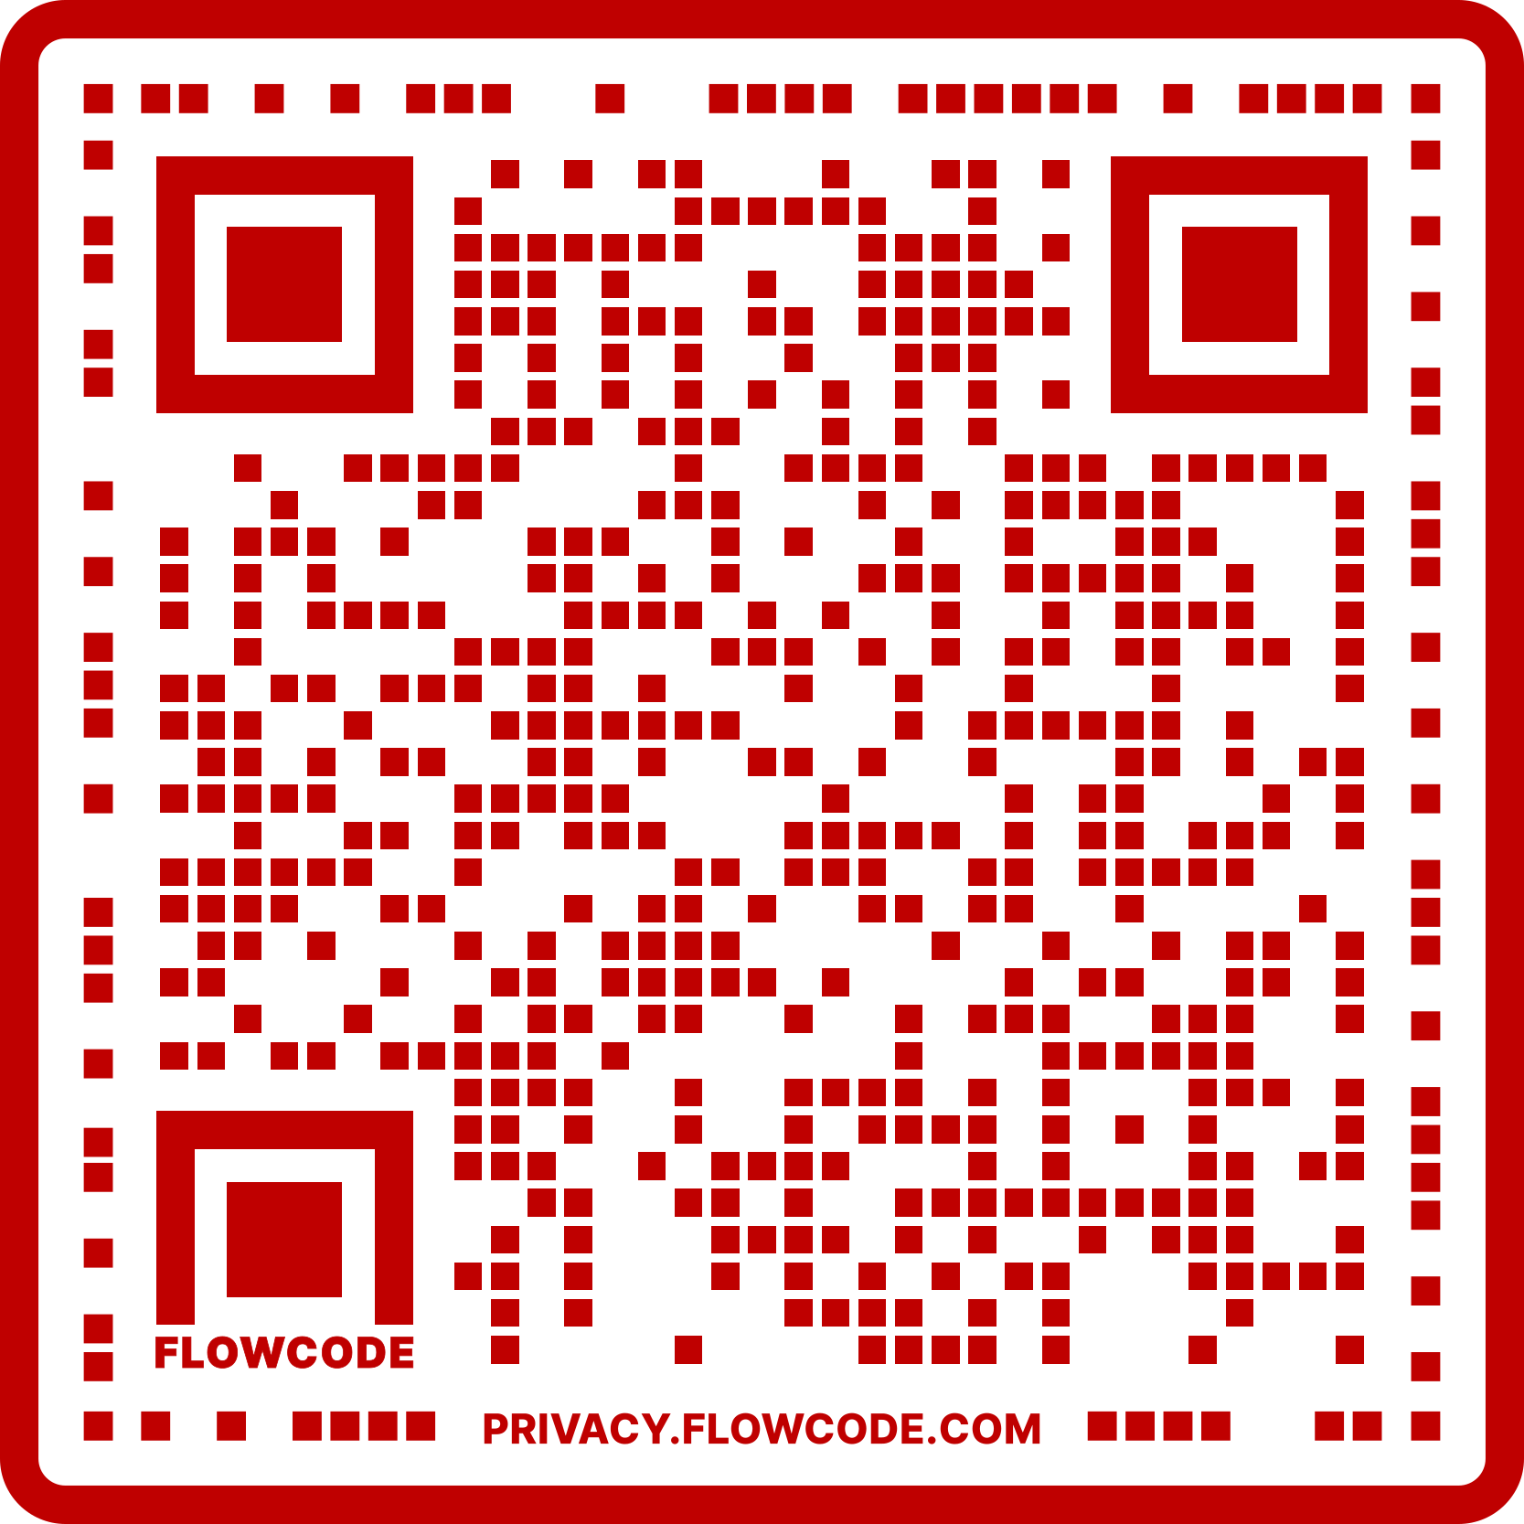

Slide 32
Works Cited
Human trafficking within schools: https://safesupportivelearning.ed.gov/human-trafficking-americas-schools
Human trafficking myths:
https://www.acf.hhs.gov/sites/default/files/documents/otip/trafficking_infographic508.pdf
https://www.dhs.gov/blue-campaign/myths-and-misconceptions#:~:text=Myth%3A%20Human%20trafficking%20and%20human%20smuggling%20are%20the%20same.&text=%E2%80%9CTrafficking%E2%80%9D%20is%20based%20on%20exploitation,in%20violation%20of%20immigration%20laws
Human trafficking victim story: https://www.ice.gov/features/human-trafficking-victim-shares-story
Notes:
Do it like this or include the proper scientific citations or keep adding the citations in the speaker notes? bibliography , “ go here to get info on…”

Slide 33
Works Cited Continued
The root causes of trafficking:
https://www.unodc.org/documents/human-trafficking/Toolkit-files/08-58296_tool_9-2. pdf
http://www.ipjc.org/wp-content/uploads/2016/09/USCSAHT%20-%20HT%20and%20Poverty.pdf
How to determine a job scam: https://theamericangenius.com/business-news/human-sex-trafficking-job-scams/
Social media’s impact on trafficking: https://polarisproject.org/wp-content/uploads/2018/08/A-Roadmap-for-Systems-and-Industries-to-Prevent-and-Disrupt-Human-Trafficking-Social-Media.pdf

Slide 34
Works Cited Continued
Human trafficking in NY:
https://humantraffickinghotline.org/state/new-york
US State Specific Trafficking Statistics: https://www.nealdavislaw.com/press/human-trafficking-statistics-2019-report.html
Analysis of 2020 human trafficking hotline data: https://polarisproject.org/wp-content/uploads/2022/01/Polaris-Analysis-of-2020-Data-from-the-National-Human-Trafficking-Hotline.pdf
How to talk to youth about human trafficking: https://www.dhs.gov/sites/default/files/publications/blue_campaign_youth_guide_508_1.pdf

Slide 35
Works Cited Continued
Overview and how traffickers maintain control of their victims: https://www.manhattanda.org/victim-resources/human-trafficking/
2020 human trafficking trends: https://polarisproject.org/wp-content/uploads/2022/01/Human-Trafficking-Trends-in-2020-by-Polaris.pdf
Brands using forced labor:
https://humantraffickingsearch.org/shopping-slavery-free/
https://environoego.com/famous-companies-that-use-slavery/

